Slide 1

Price Analysis of cars at different locations

Slide 2

About us:
P Ranjith kumar (MBA)
P Venkatramana (BTECH)
why Data science ?
Data science is high in demand and explains how digital data is transforming businesses and helping them make sharper and critical decisions.
Work Experience (Internships):-
Sales Marketing and Business Development in Jeevamrut Pvt.Ltd.
Hiring and HR Operations in ITC Limited.

Slide 3
Contents :-
Problem statement
Libraries Used
Raw data
Web Scraping
Data manipulation /Data cleaning
EDA(Exploratory Data Analysis)
Objective
Conclusion

Slide 4
PROBLEM STATEMENT:
Price Analysis based on the different Locations.
Price Analysis based on the different Company.

Slide 5
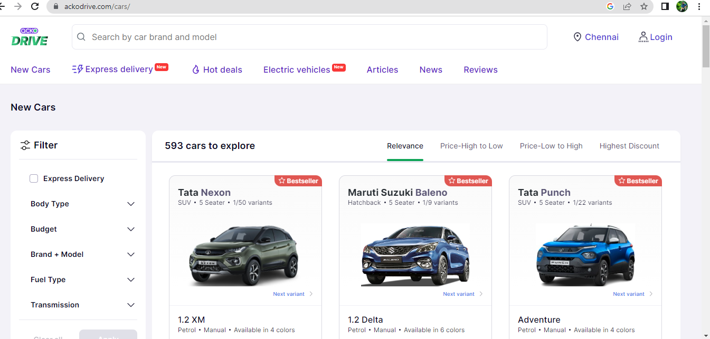
Website :-

Slide 6






NumPy
Pandas
BeautifulSoup
Requests
Matplotlib
RegEx
seaborn
LIBRARIES USED:

Slide 7
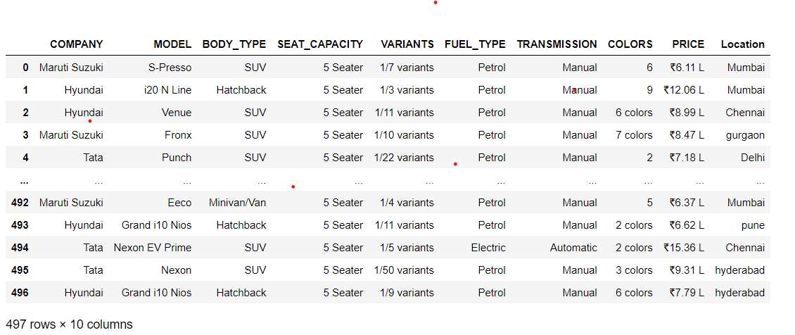
Raw Data :-

Slide 8
Data cleaning Steps :-
Identifying missing values (NAN’s)
Drop the duplicated columns and unnecessary columns
Removing special characters
filling or dropping the missing values
Data type conversion

Slide 9
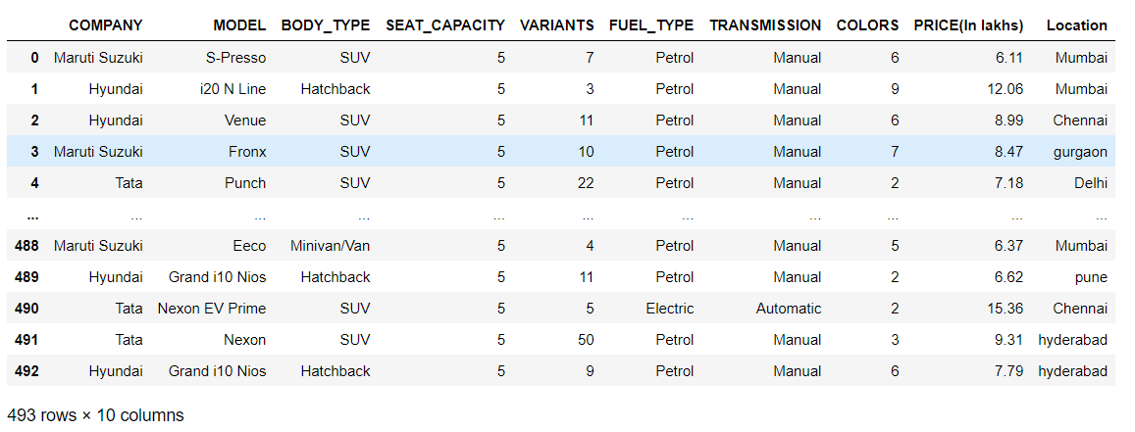
Cleaned Data :-

Slide 10
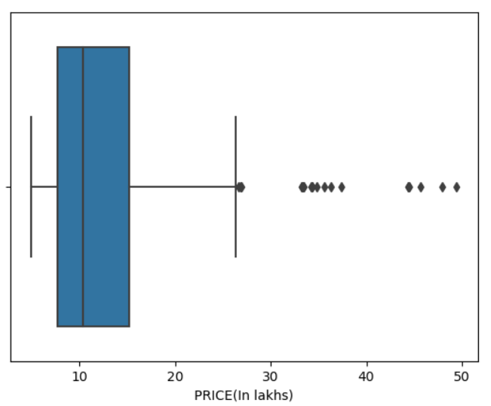
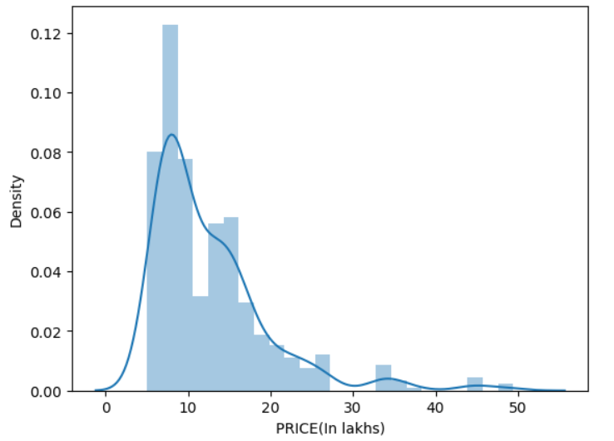
The above Box plot shows Outliers in particular column.
Using Dist plot we can find the distribution of column.

Slide 11
DATA VISUALIZATION
Uni-Variate Analysis:
Uni variate data consists of only one variable. The information deals with only one quantity that changes.
Categorical & Numerical
Bi-Variate Analysis:
Bivariate data involves two different variable. The analysis is done to find out the relationship among the two variables.
Categorical and Categorical , 2 Categorical and numerical ,3 Numerical and numerical
Multi-Variate analysis:
Multivariate analysis have required when more than two variables have to be analysed simultaneously.
Two Categorical and one Numerical
Two Numerical and one Categorical
Three or more Numerical

Slide 12
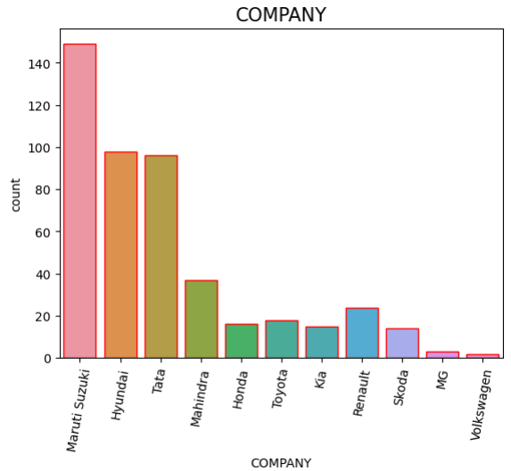
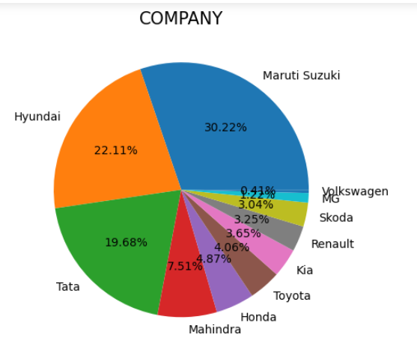
Uni-Variate Analysis:
The given pie chart shows the percentage of the Companies which are having more sales in the market.
The above countplot shows the no of cars of each company

Slide 13
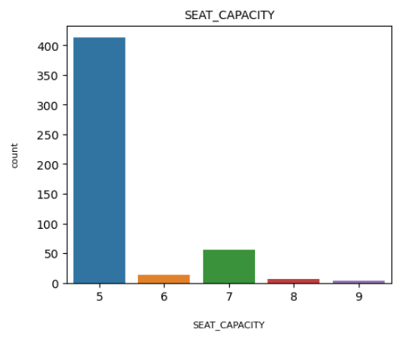
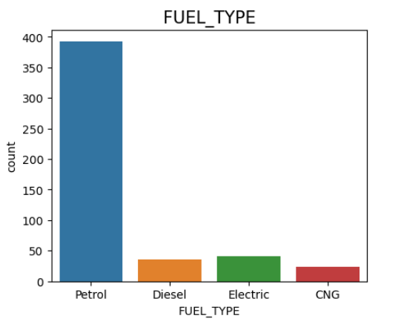
The above countplot shows the no of cars are available in the following seat capacitiy
The above countplot shows the no of cars are available in the following fuel type variants

Slide 14
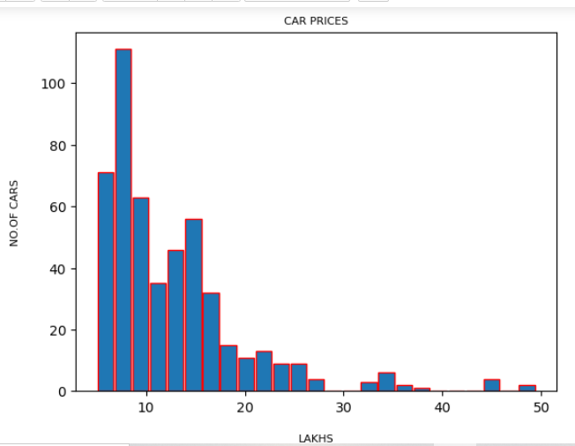
The above histogram shows the no of cars prices in lakhs

Slide 15
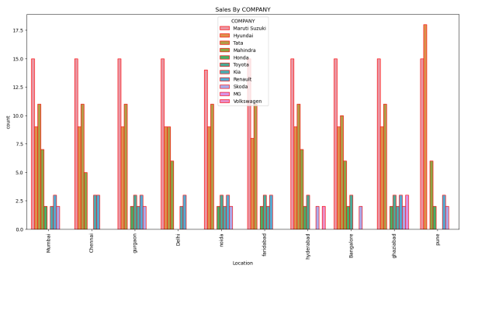
The above countplot shows the sales of cars of a company at different locations
Bi-Variate Analysis:

Slide 16
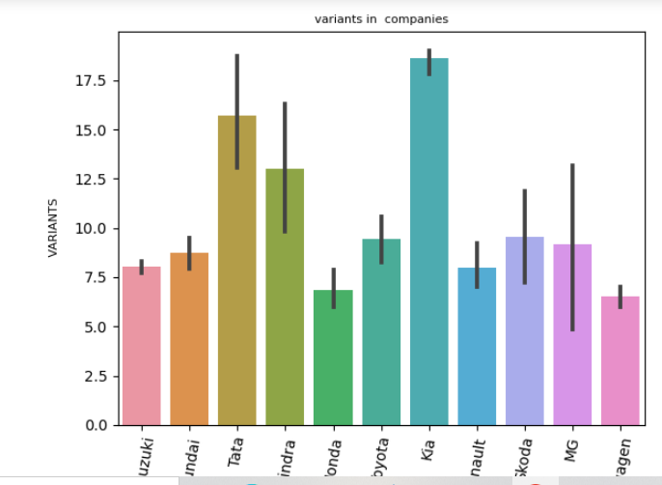
COMPANY AND VARIENTS
The above barplot shows the varients in each company

Slide 17
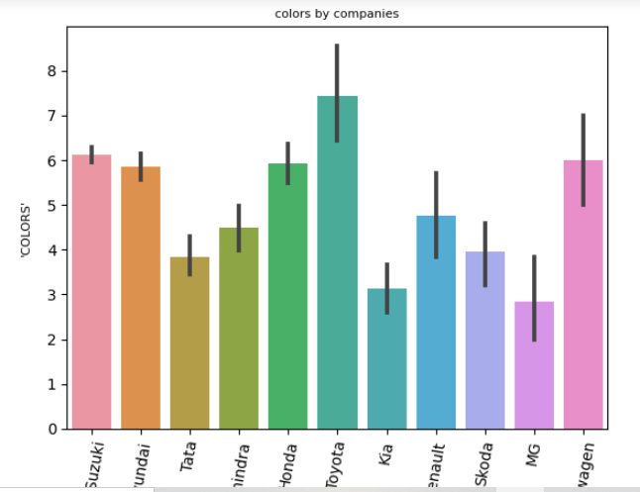
Company and colors
The above barplot shows the colors available in each company

Slide 18
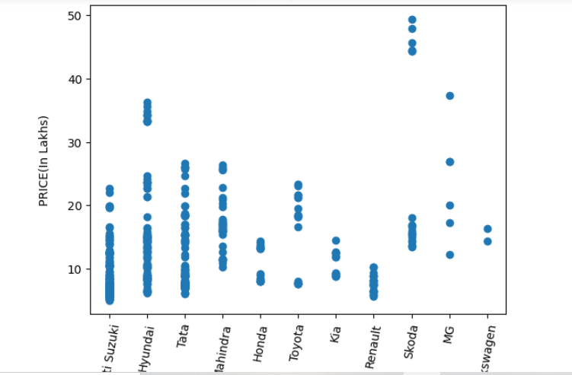
The above scatter plot shows the price range of cars in each company

Slide 19
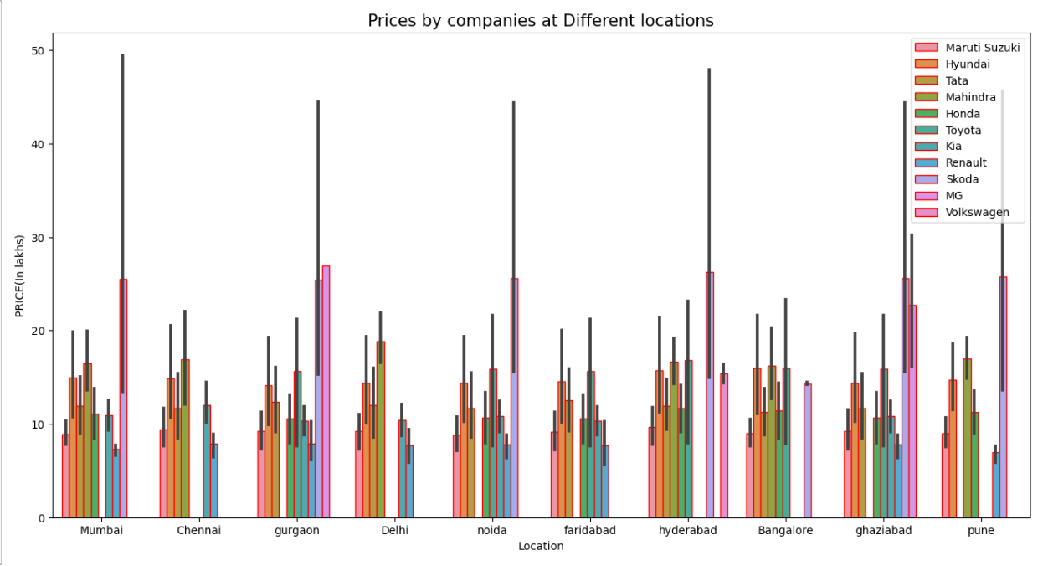
Multi-Variate analysis:
The above barplot shows price ranges of companies in each city

Slide 20
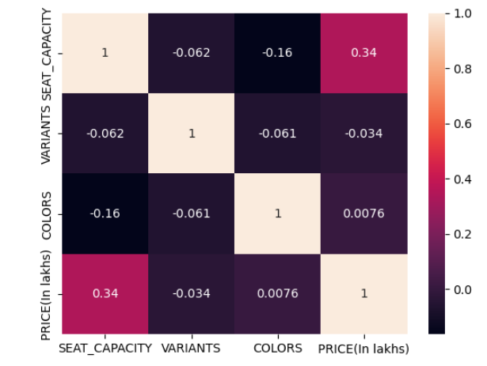
Heat Map :

Slide 21
Challenges Faced:
While doing webscraping we faced lot of difficulties to extract
the data initially.
By using regressions we extracted the data easily.
Selecting the appropriate type of plot for your data can be tricky.

Slide 22
→ The analysis clearly demonstrates that location plays a significant role in determining car prices. → Affluent areas tend to have higher car prices, while non-affluent areas exhibit relatively lower prices. → Car prices vary significantly with factors such as regional preferences, fuel type, transmission, and market competition playing a crucial role.
Conclusion:

Slide 23
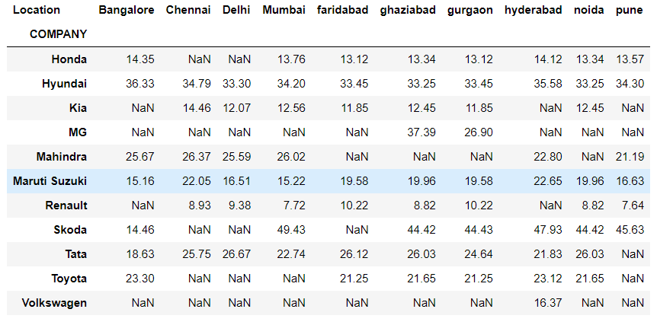
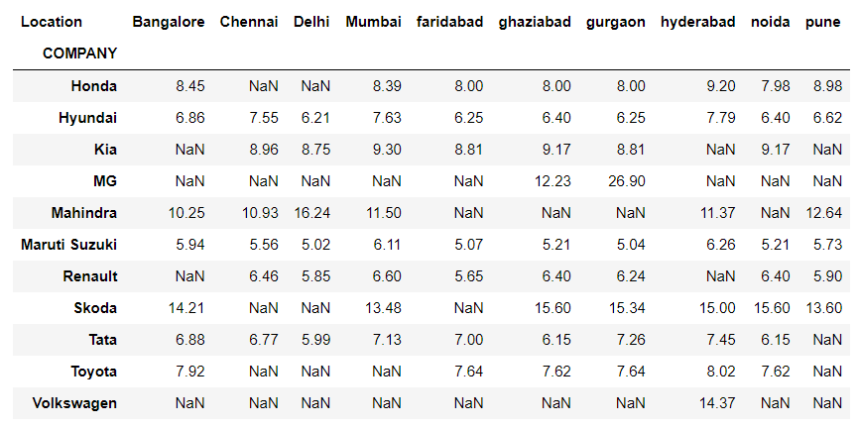
Q/A :
What is the Max & Min Prices of each Company at each location?

Slide 24
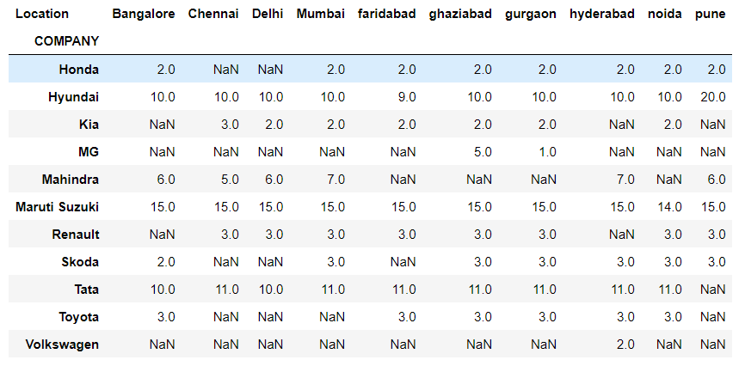
2. How many models do you have at each location?

Slide 25
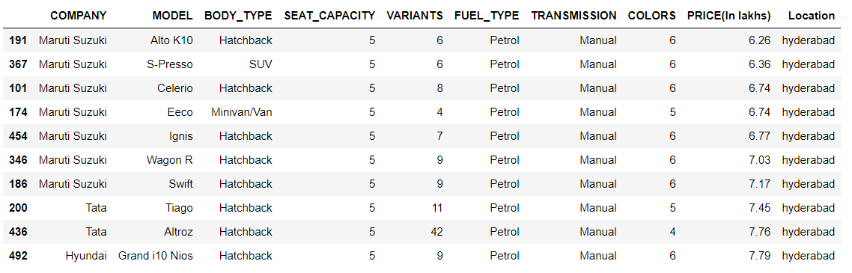
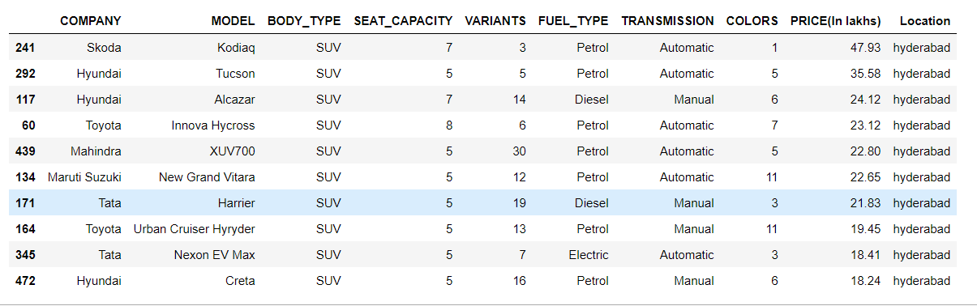
3. Top 10 Cars having least & highest prices in Hyderabad?

Slide 26
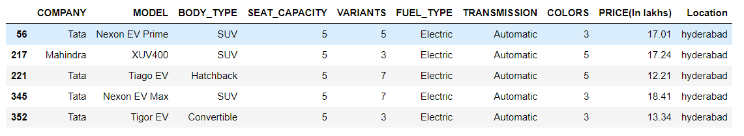
4. Which Car has more Variants?
5. How many electric cars available in Hyderabad?

Slide 27


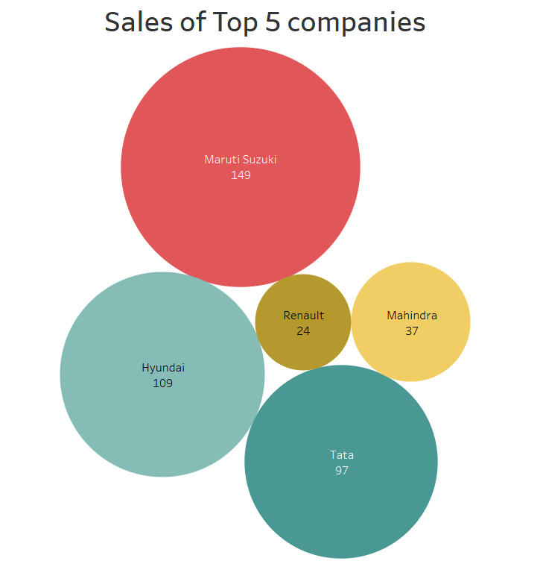

6. Sales of top 5 Companies

Slide 28


